Slide 1
bin/activate

Slide 2

Intro to django
The magical world of python publishing on the web!

Slide 3

Meet Django Pony

Slide 4
What is this this Django Magic?
Django is a Python Web Publishing Framework
Built by Journalists for rapid development of data-driven websites and web applications
Used at large and Small publications

Slide 5
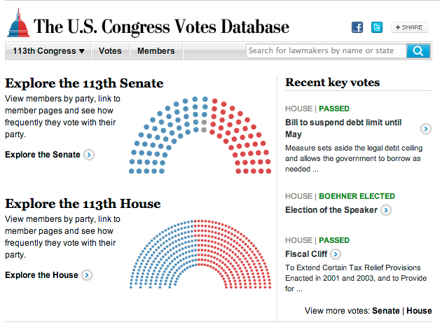
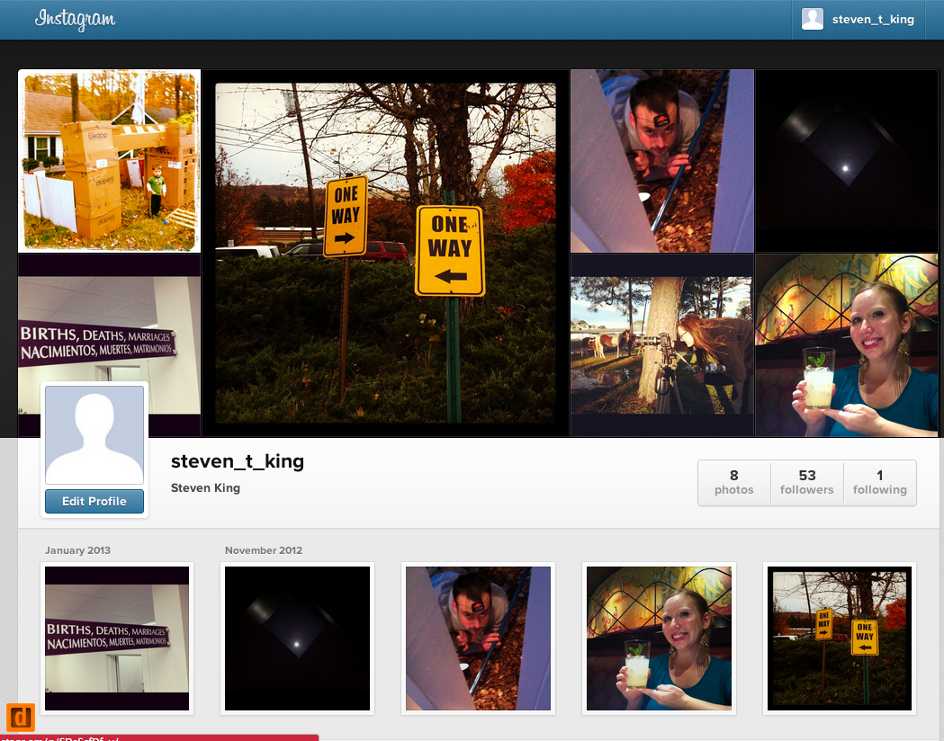
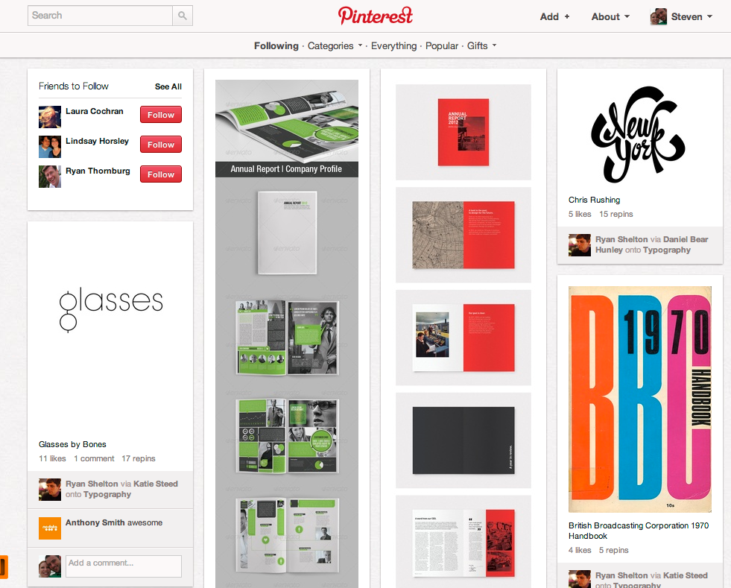
Who Uses it?
Washington Post
National Geographic
The Onion
Instagram
Pinterest

Slide 6
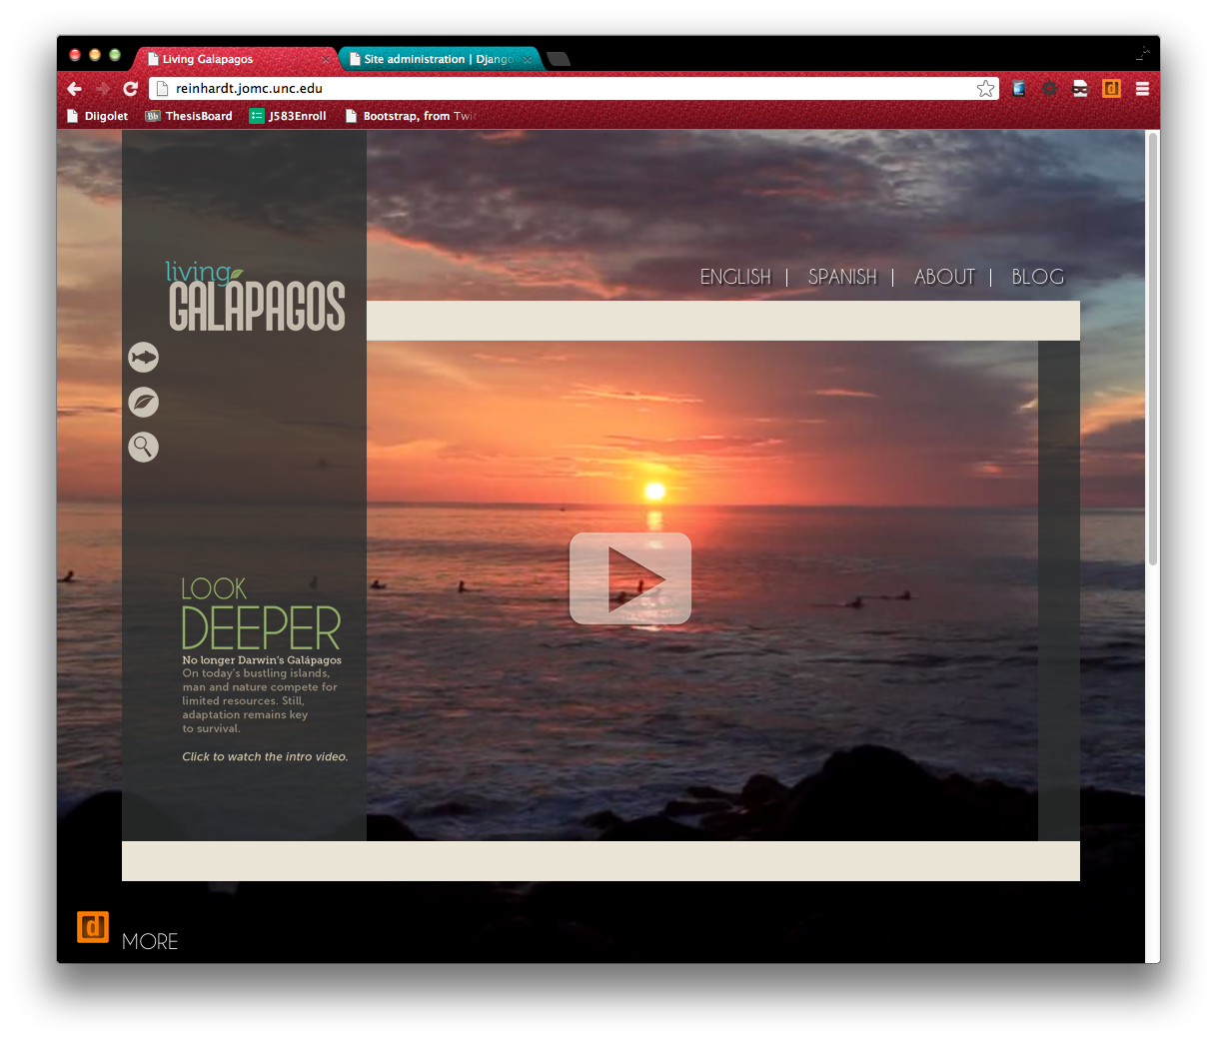
UNC Example

Slide 7
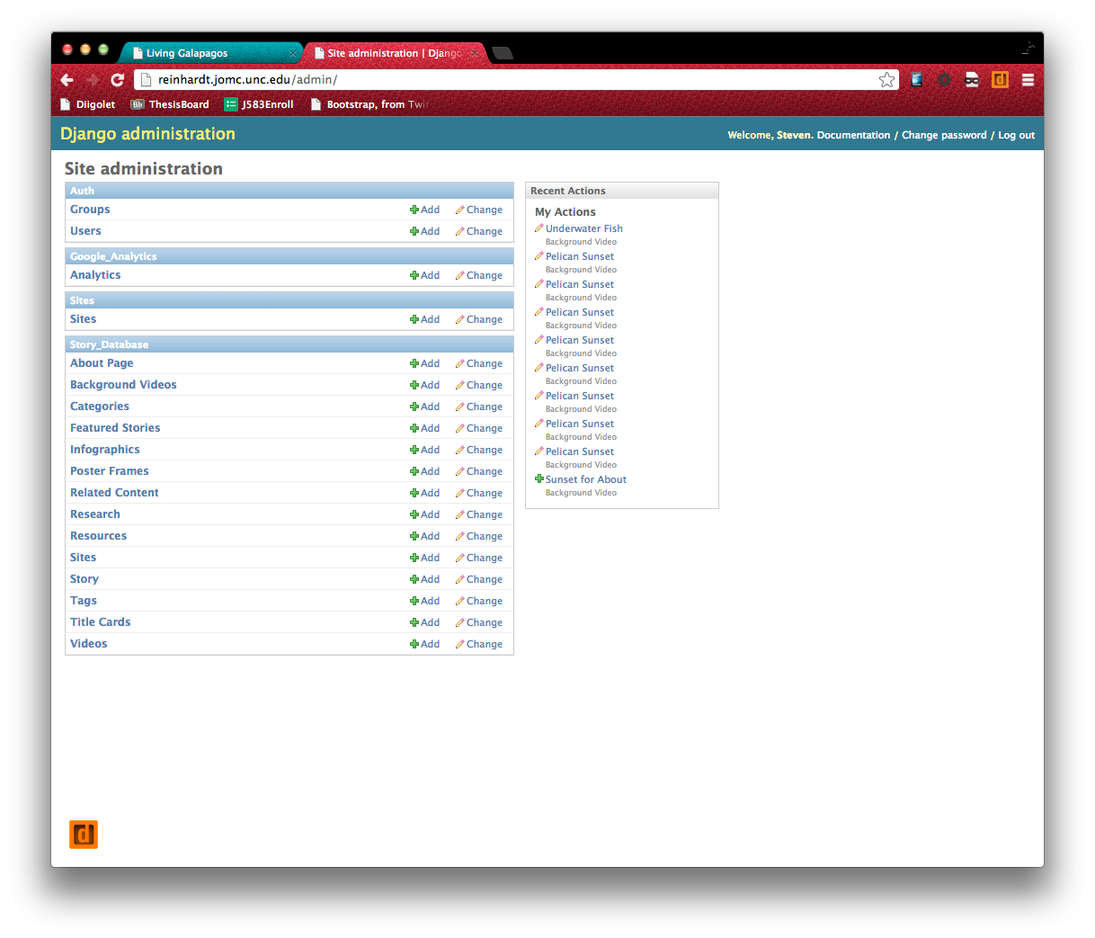
UNC Example

Slide 8
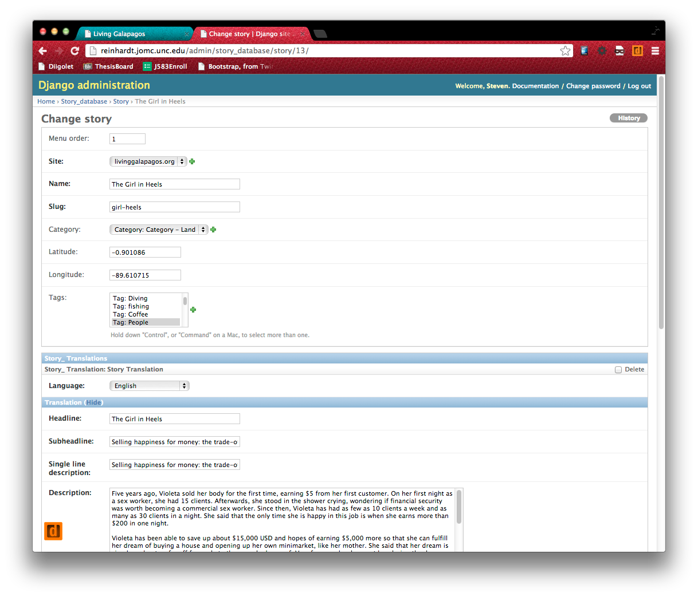
UNC Example

Slide 9
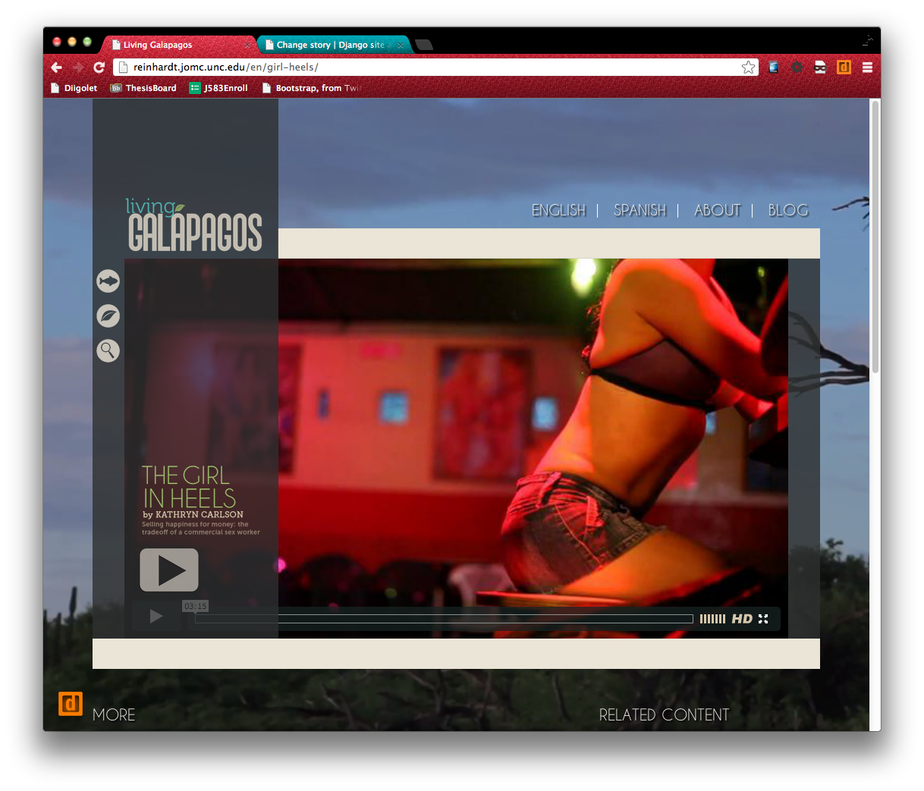
UNC Example

Slide 10
Overview of a Django Project
Project Source Code
External Applications
Static Resources
Media
Django Project
Web Server Config
Database Server Config
Deployment Tools
Monitoring

Slide 11
Install a bunch of stuff!
Ubuntu
The base dockerfile is included. This file sets up a basic ubuntu container ready for us to work from.
docker pull ubuntu:16.04
Postgres
We will be using the Postgres database.
https://www.postgresql.org/
docker pull postgres
Postico
Download and install Postico so we can administer our database.
https://eggerapps.at/postico/
Django

Slide 12
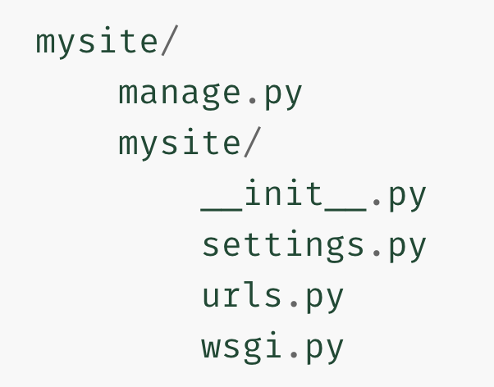
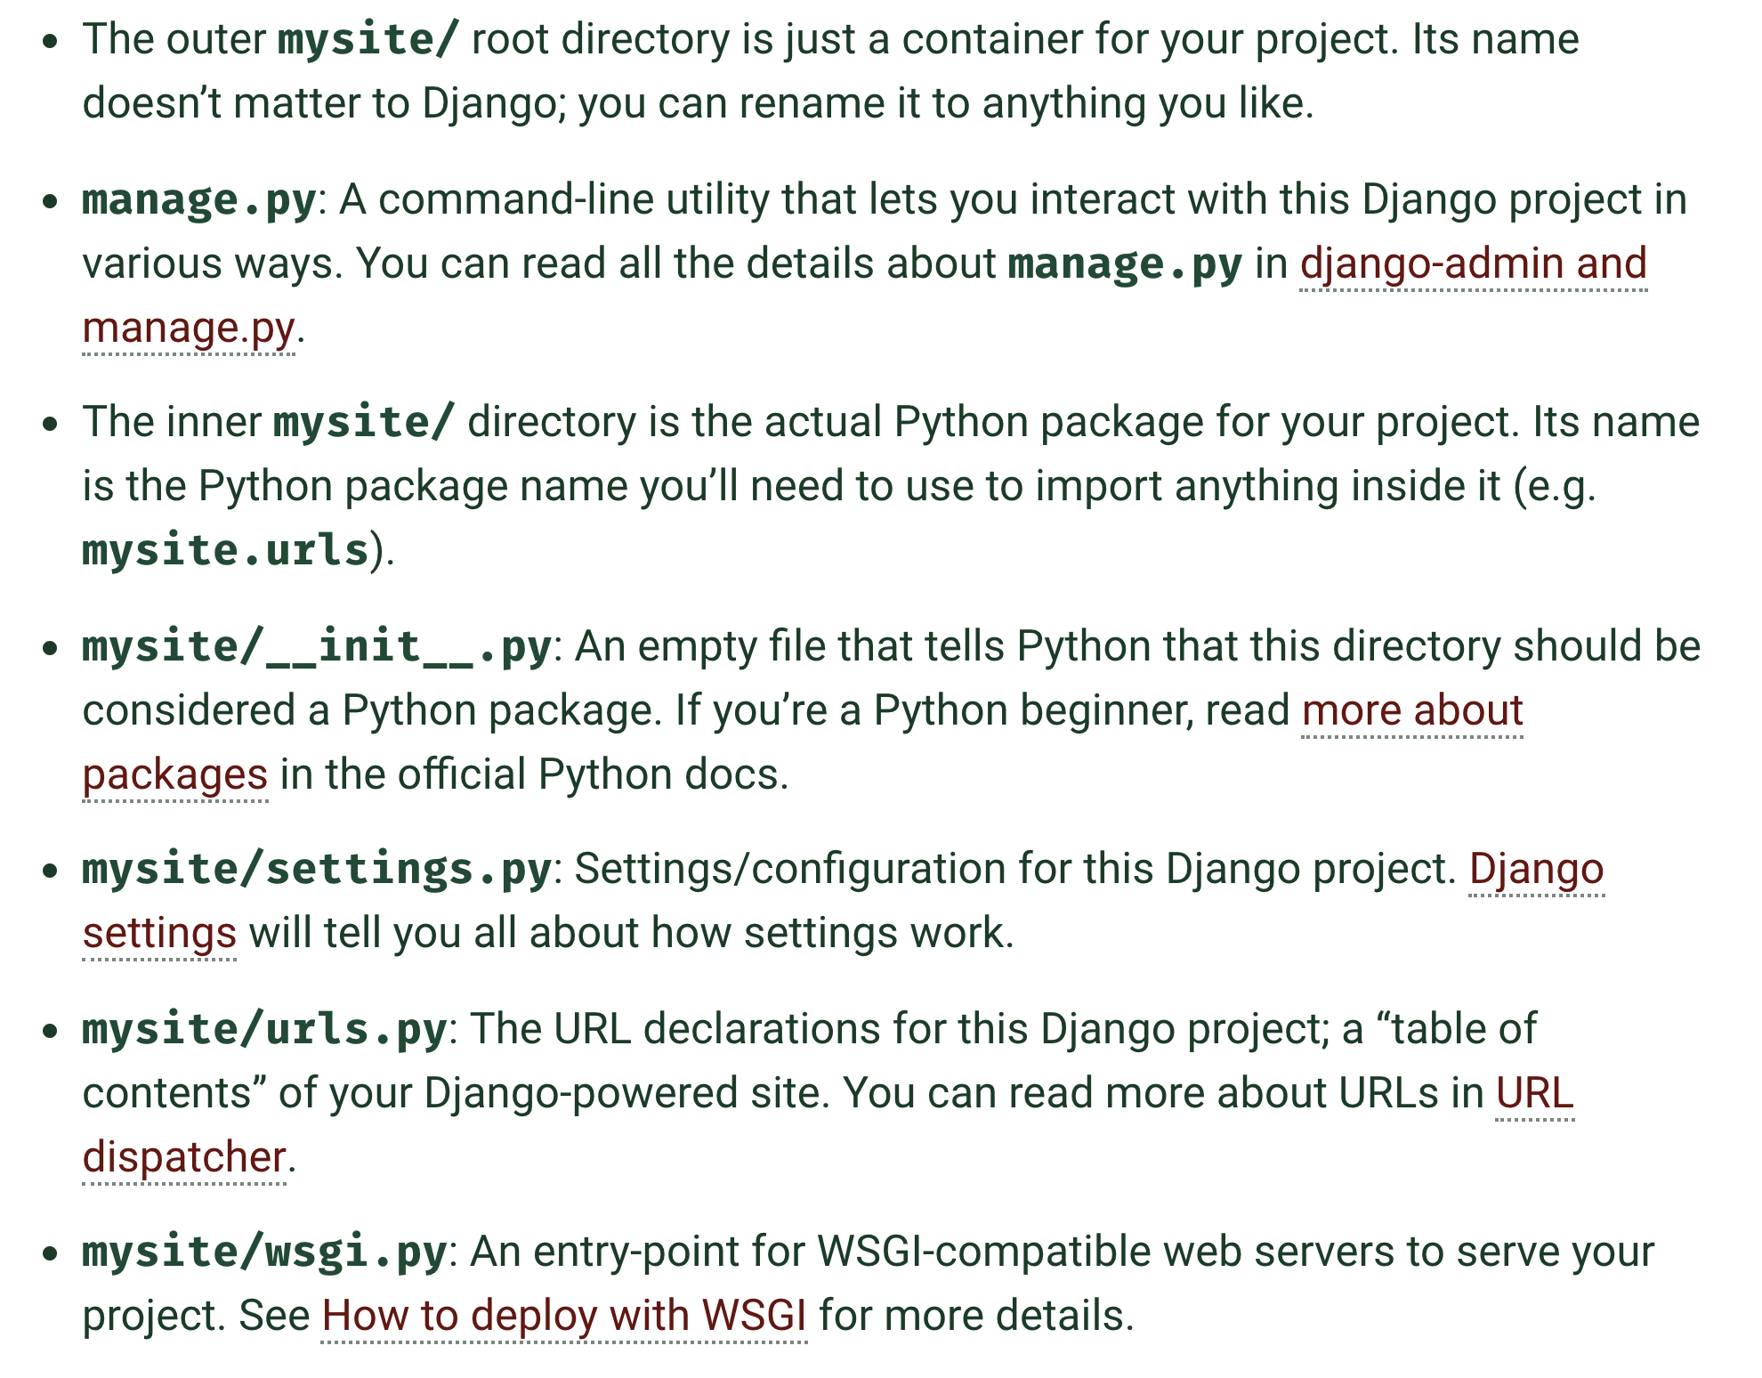
PROJECT FILES

Slide 13
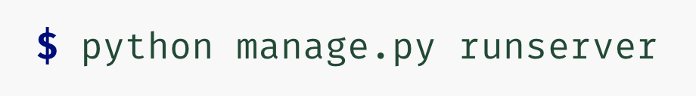
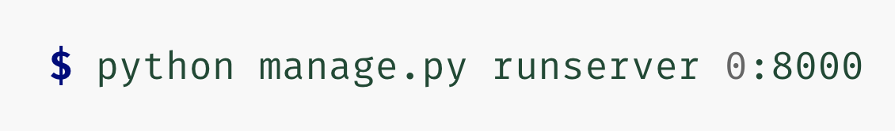

Django Commands

Slide 14
Understanding Django Concepts

Slide 15
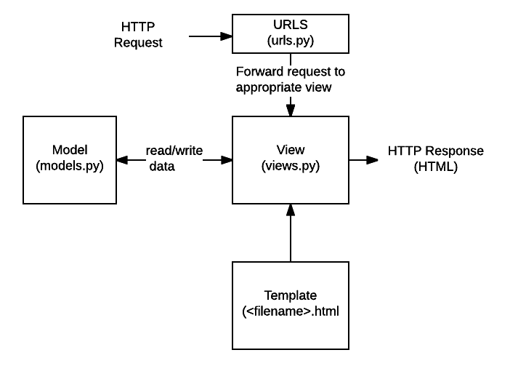
Models, Views, URLs and Templates
Understanding how things work

Slide 16
Models
A model is the single, definitive source of information about your data.
Generally, each model maps to a single database table.
The basics: Each model is a Python class that subclasses django.db.models.Model .
Each attribute of the model represents a database field.

Slide 17
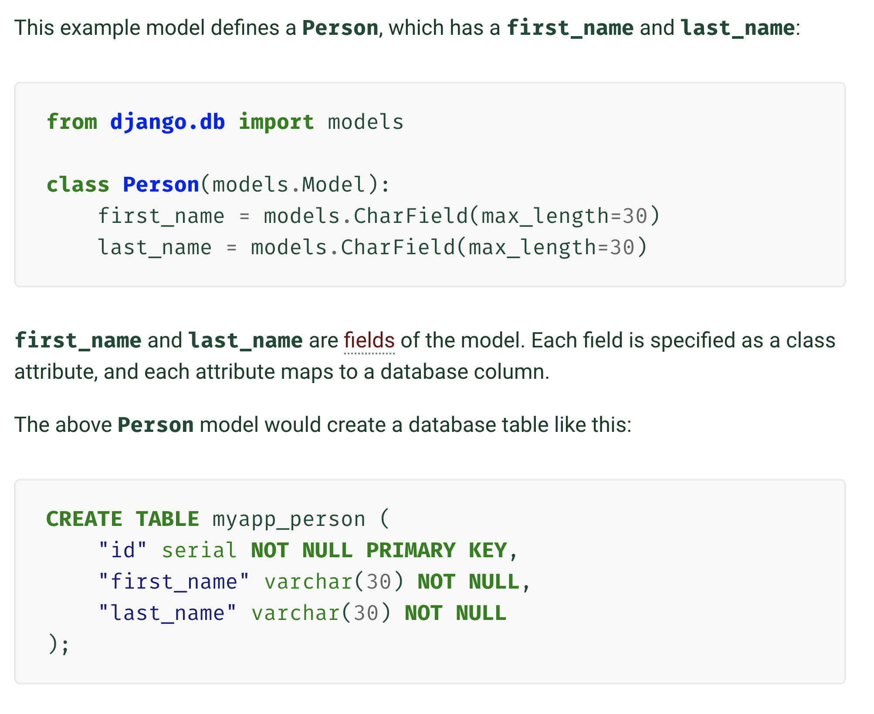
models.py

Slide 18
Views
A view function, or view for short, is simply a Python function that takes a Web request and returns a Web response.
In static terms, you might think of it as “type of page”
Sport View
Team View
Player View

Slide 19
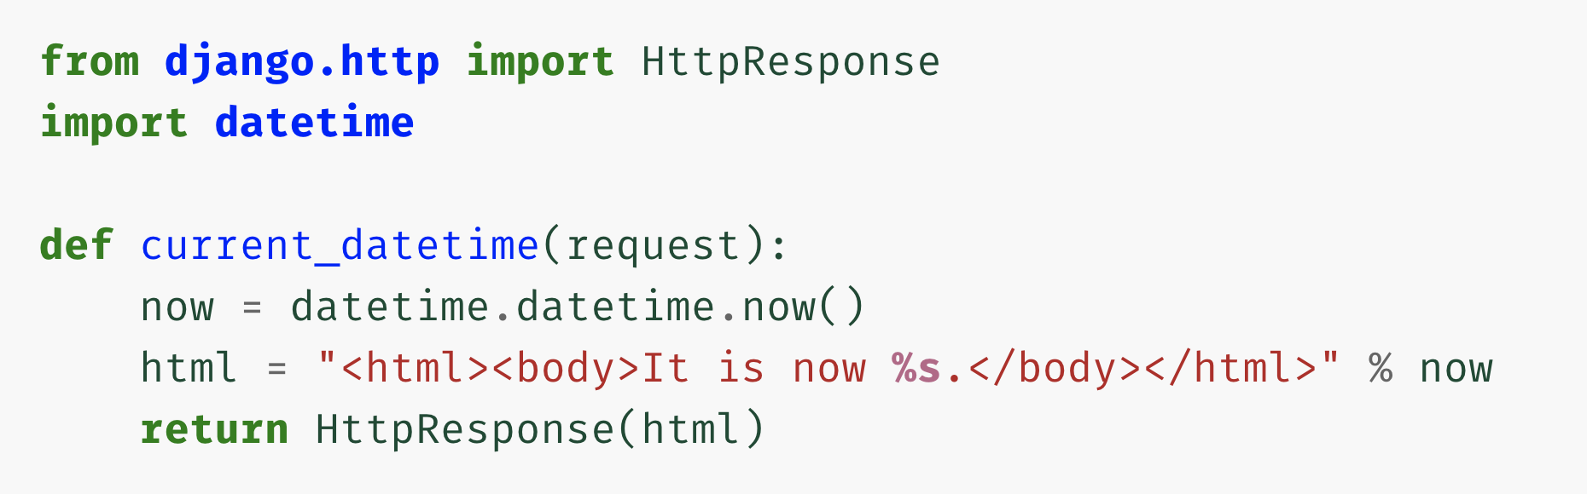
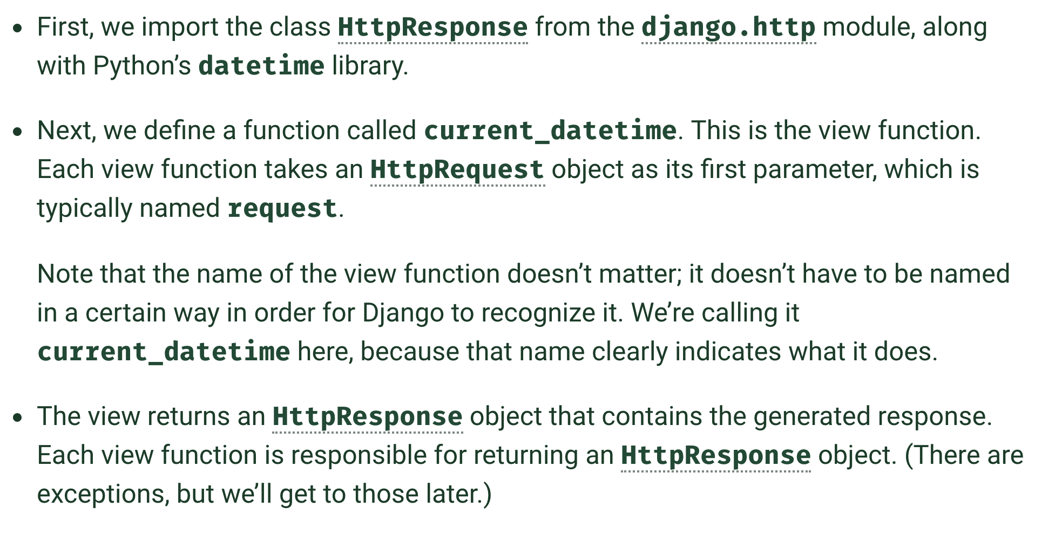
view.py

Slide 20
view.py

Slide 21
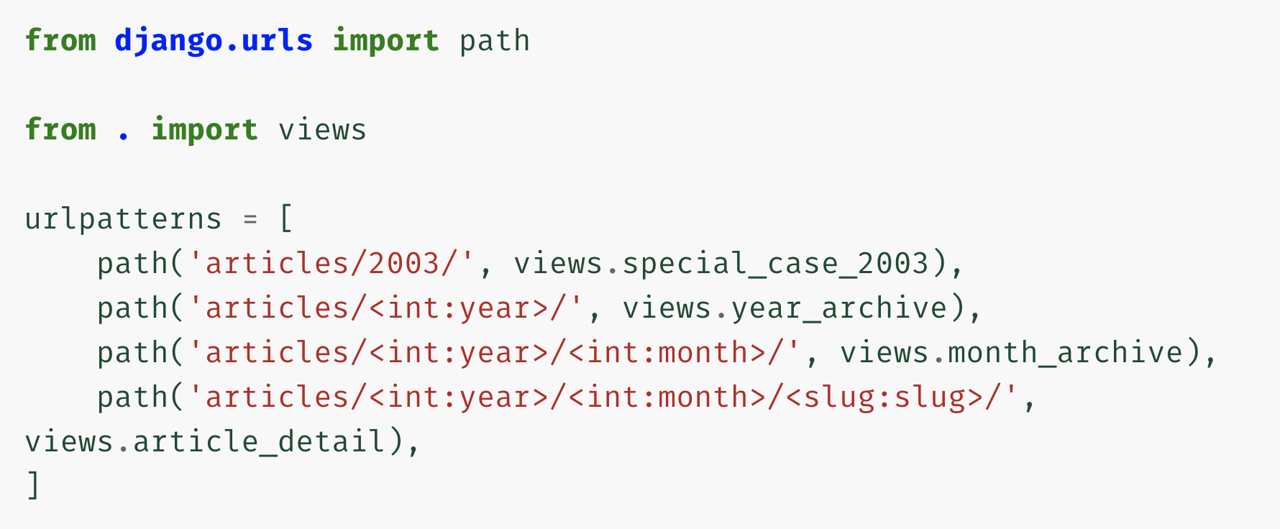
URL Dispatcher

Slide 22
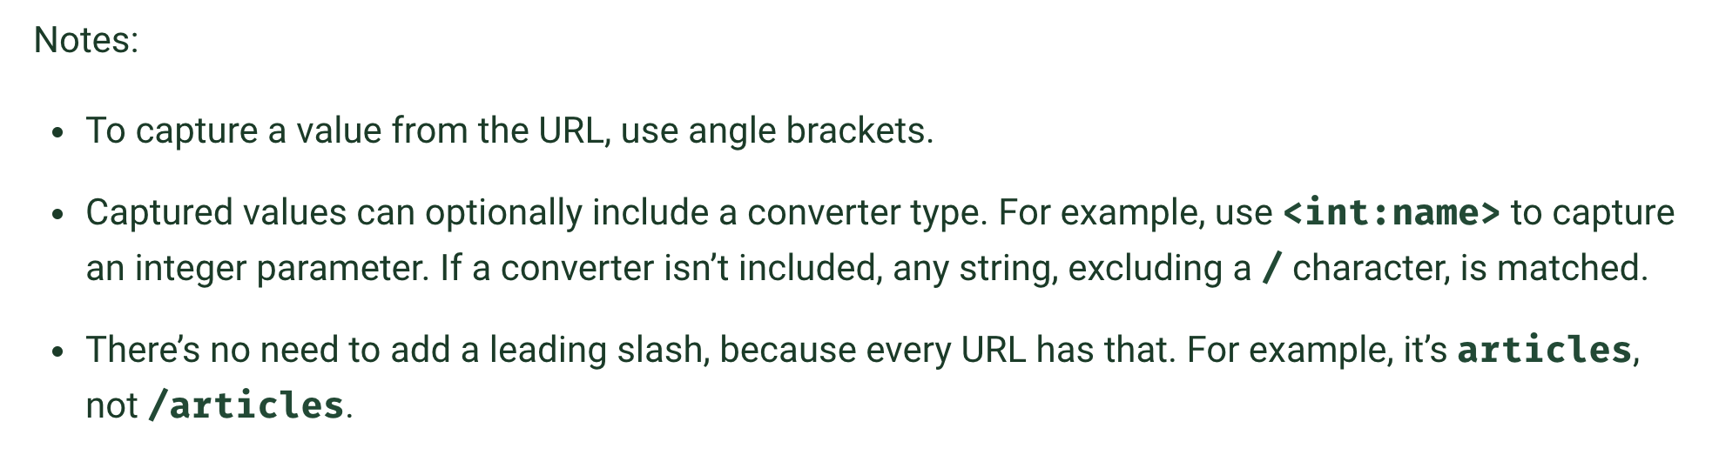
urls.py

Slide 23
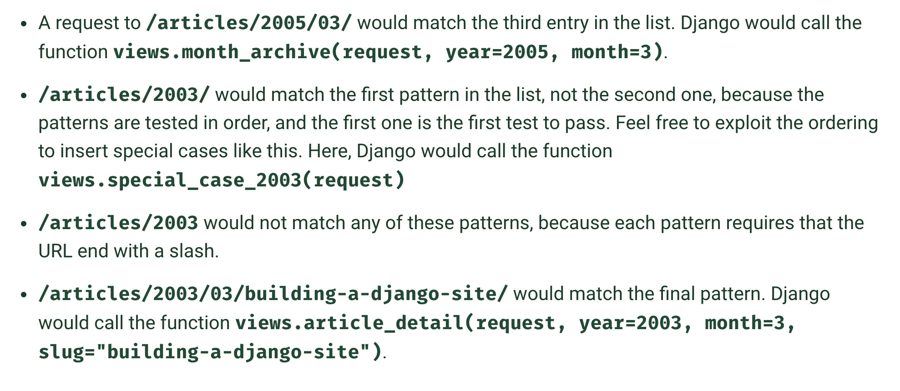
urls.py

Slide 24
Understanding

Slide 25
Apps and Projects
A project refers to the entire application and all its parts.
An app refers to a submodule of the application. It should be self-contained and not intertwined with other apps
All projects must have at least one app, typically called the same name as the project

Slide 26
Settings File

Slide 27
Settings File
These are common settings for Django projects
PROJECT_PATH & PROJECT_ROOT
DEBUG
DATABASES
STATIC_ROOT & MEDIA_ROOT
STATIC_URL & MEDIA_URL
TEMPLATE_DIRS
INSTALLED_APPS

